Slide 1
Chapter 11: Managing a Secure Network
CCNA Security v2.0

Slide 2
Chapter Outline
11.0 Introduction
11.1 Network Security Testing
11.2 Developing a Comprehensive Security Policy
11.3 Summary

Slide 3
Section 11.1: Network Security Testing
Upon completion of this section, you should be able to:
Describe the techniques used in network security testing.
Describe the tools used in network security testing.

Slide 4
Topic 11.1.1: Network Security Testing Techniques
Mitigating network attacks requires a comprehensive, end-to-end approach that includes creating and maintaining security policies based on the security needs of an organization.
The first step in establishing the security needs of an organization is to identify likely threats and perform a risk analysis

Slide 5

Operations Security
Operations security is concerned with the day-to-day practices necessary to first deploy and later maintain a secure system.
All networks are vulnerable to attack if the planning, implementation, operations, and maintenance of the network do not adhere to operational security practices.
Operations security starts with the planning and implementation process of a network. During these phases, the operations team analyzes designs, identifies risks and vulnerabilities and makes the necessary adaptations.
The actual operational tasks begin after the network is set up and include the continual maintenance of the environment. These activities enable the environment, systems, and applications to continue to run correctly and securely.
Notes:
11.1.1.1 Operations Security

Slide 6
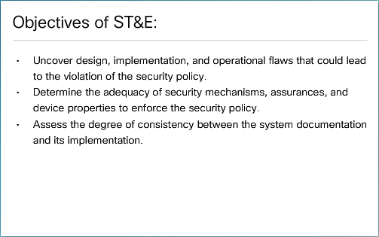
Testing and Evaluating Network Security
ST&E – Security Testing & Evaluation
The effectiveness of an operations security solution can be tested without waiting for a real threat to take place. Network security testing makes this possible. Network security testing is performed on a network to ensure all security implementations are operating as expected. Typically, network security testing is conducted during the implementation and operational stages, after the system has been developed, installed, and integrated.
Notes:
11.1.1.2 Testing and Evaluating Network Security

Slide 7

Types of Network Tests
Integrity checkers - An integrity checking system detects and reports on changes in the system. Most of the monitoring is focused on the file system. However, some checking systems can report on login and logout activities.
Operational Status of the Network:
Penetration testing
Network scanning
Vulnerability scanning
Password cracking
Log review
Integrity checks
Virus detection
Notes:
11.1.1.3 Types of Network Tests

Slide 8

Applying Network Test Results
Network security testing results can be used in several ways:
To define mitigation activities to address identified vulnerabilities
As a benchmark to trace the progress of an organization in meeting security requirements
To assess the implementation status of system security requirements
To conduct cost and benefit analysis for improvements to network security
To enhance other activities, such as risk assessments, certification and authorization (C&A), and performance improvement efforts
As a reference point for corrective action
Notes:
11.1.1.4 Applying Network Test Results

Slide 9
Topic 11.1.2: Network Security Testing Tools

Slide 10

Network Testing Tools
SIEM (Security Information Event Management) - A technology used in enterprise organizations to provide real time reporting and long-term analysis of security events
GFI LANguard - Network and security scanner which detects vulnerabilities
Tripwire - Assesses and validates IT configurations against internal policies, compliance standards, and security best practices
Nessus - Vulnerability scanning software, focusing on remote access, misconfigurations, and DoS against the TCP/IP stack
L0phtCrack - Password auditing and recovery application
Metasploit - Provides information about vulnerabilities and aids in penetration testing and IDS signature development
Nmap/Zenmap
SuperScan
SIEM
GFI LANguard
Tripwire
Nessus
L0phtCrack
Metasploit
Notes:
11.1.2.1 Network Testing Tools

Slide 11
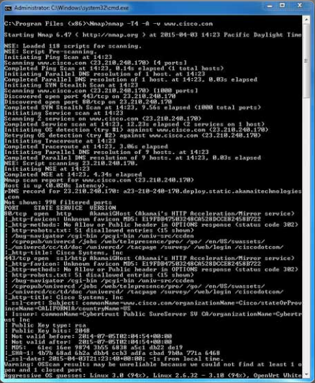
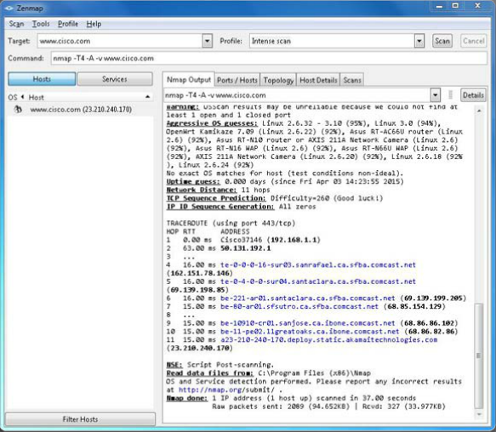
Nmap and Zenmap
Zenmap is the GUI version of Nmap, as shown in Figure 2.
Sample Nmap Screenshot
Sample Zenmap Screenshot
Notes:
11.1.2.2 Nmap and Zenmap

Slide 12
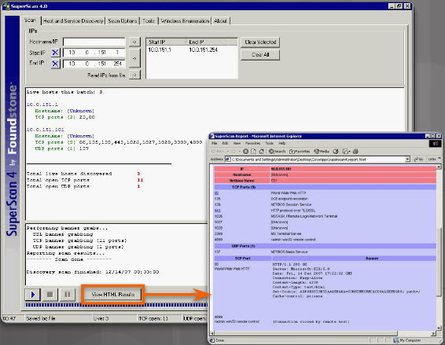
SuperScan
SuperScan is a Microsoft Windows port scanning tool. It runs on most versions of Windows and requires administrator privileges. SuperScan version 4 has a number of useful features:
Notes:
11.1.2.3 SuperScan

Slide 13
SIEM
Security Information Event Management (SIEM) is a technology used in enterprise organizations to provide real time reporting and long-term analysis of security events.
SIEM evolved from two previously separate products: Security Information Management (SIM) and Security Event Management (SEM). SIEM can be implemented as software, integrated with Cisco Identity Services Engine (ISE) or as a managed service.
SIEM combines the essential functions of SIM and SEM to provide:
Forensic analysis – The ability to search logs and event records from sources throughout the organization provides more complete information for forensic analysis.
Correlation – Examines logs and events from disparate systems or applications, speeding detection of and reaction to security threats.
Aggregation - Aggregation reduces the volume of event data by consolidating duplicate event records.
Retention - Reporting presents the correlated and aggregated event data in real-time monitoring and long-term summaries.
Essential functions:
Forensic Analysis
Correlation
Aggregation
Retention
Notes:
11.1.2.4 SIEM
11.1.2.5 Activity – Identify Network Security Testing Tools

Slide 14
Section 11.2: Developing a Comprehensive Security Policy
Upon completion of this section, you should be able to:
Explain the purpose of a comprehensive security policy.
Describe the structure of a comprehensive security policy.
Describe the standards, guidelines, and procedures of a security policy.
Explain the roles and responsibilities entailed by a security policy.
Explain security awareness and how to achieve through education and training.
Explain how to respond to a security breach.

Slide 15
Topic 11.2.1: Security Policy Overview

Slide 16

Secure Network Life Cycle
Determine what the assets of an organization are by asking:
What does the organization have that others want?
What processes, data, or information systems are critical to the organization?
What would stop the organization from doing business or fulfilling its mission?
The Secure Network Life Cycle is a process of assessment and re-evaluation of equipment and security needs as the network changes. One important aspect of this ongoing evaluation is to understand which assets an organization must protect, even as those assets are changing.
Notes:
11.2.1.1 Secure Network Life Cycle

Slide 17
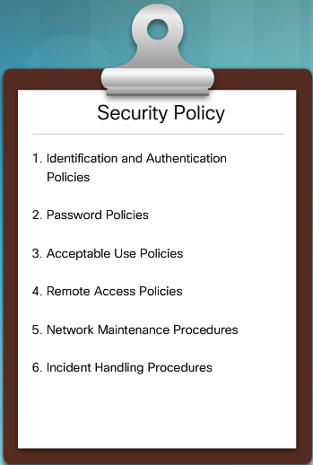
Security Policy
A security policy is a set of security objectives for a company, rules of behavior for users and administrators, and system requirements.
These objectives, rules, and requirements collectively ensure the security of a network, the data, and the computer systems in an organization.
Much like a continuity plan, a security policy is a constantly evolving document based on changes in technology, business, and employee requirements.
Identification and authentication policies - Specifies authorized persons that can have access to network resources and outlines verification procedures.
Password policies - Ensures passwords meet minimum requirements and are changed regularly.
Acceptable use policies - Identifies network resources and usages that are acceptable to the organization. It may also identify ramifications if this policy is violated.
Remote access policies - Identifies how remote users can access a network and what is accessible via remote connectivity.
Network maintenance policies - Specifies network device operating systems and end user application update procedures.
Incident handling policies - Describes how security incidents are handled.
Notes:
11.2.1.2 Security Policy

Slide 18



Security Policy Audience
The audience for the security policy is anyone who has access to the network, as shown in the figure.
The internal audience includes various personnel, such as managers and executives, departments and business units, technical staff, and employees.
The external audience is also a varied group that includes partners, customers, suppliers, consultants, and contractors.
It is likely that one document does not meet the needs of the entire audience of a large organization.
The goal is to ensure that the various information security policy documents are consistent with the needs of the intended audience.
Audience Determines Security Policy Content
Notes:
11.2.1.3 Security Policy Audience

Slide 19
Topic 11.2.2: Structure of a Security Policy

Slide 20
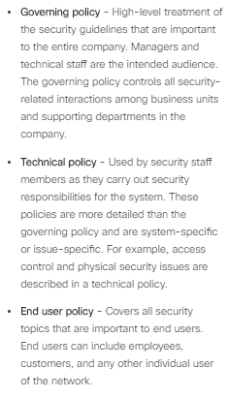
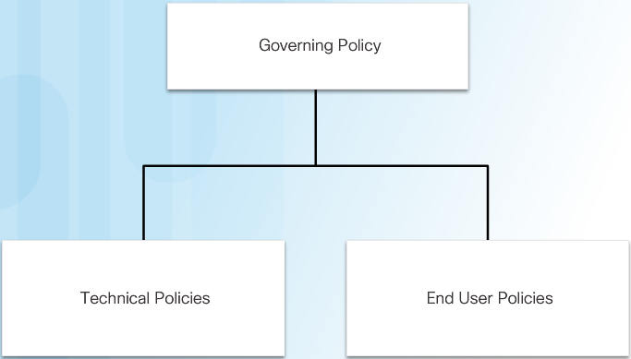
Security Policy Hierarchy
Notes:
11.2.2.1 Security Policy Hierarchy

Slide 21

Governing Policy
A governing policy includes:
Statement of the issue that the policy addresses
How the policy applies in the environment
Roles and responsibilities of those affected by the policy
Actions, activities, and processes that are allowed (and not allowed)
Consequences of noncompliance
Notes:
11.2.2.2 Governing Policy

Slide 22

Technical Policies
Technical components:
General policies
Telephony policy
Email and communication policy
Remote access policy
Network policy
Application policy
Notes:
11.2.2.3 Technical Policies

Slide 23
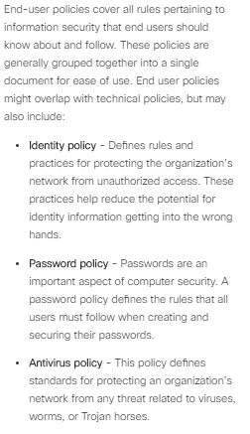



End User Polices
Customize End-User Policies for Groups
Notes:
11.2.2.4 End User Policies
11.2.2.5 Activity – Identify Security Policy Components

Slide 24
Topic 11.2.3: Standards, Guidelines, and Procedures

Slide 25

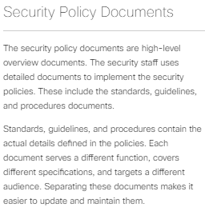
Security Policy Documents
Notes:
11.2.3.1 Security Policy Documents

Slide 26

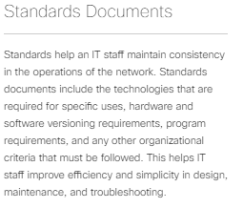
Standards Documents
Notes:
11.2.3.2 Standards Documents

Slide 27
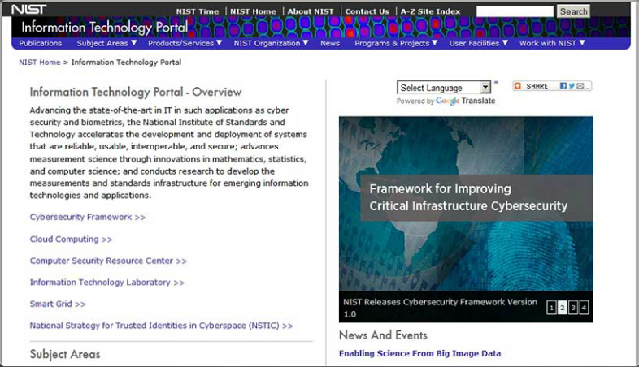
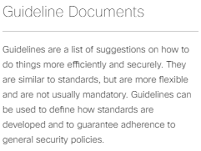
Guideline Documents
NIST Information Technology Portal
Notes:
11.2.3.3 Guideline Documents

Slide 28
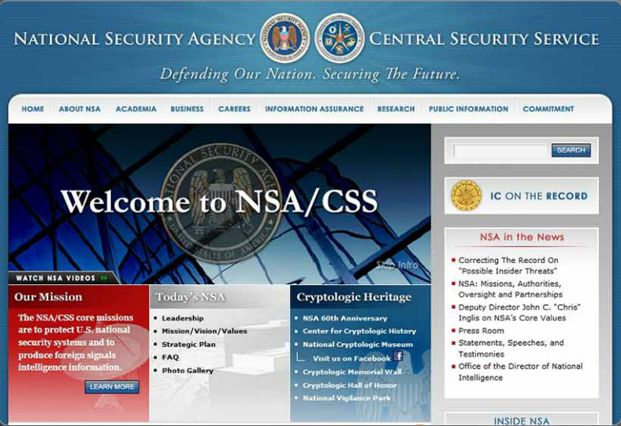
Guideline Documents (Cont.)
NSA Website
Notes:
11.2.3.3 Guideline Documents (Cont.)

Slide 29
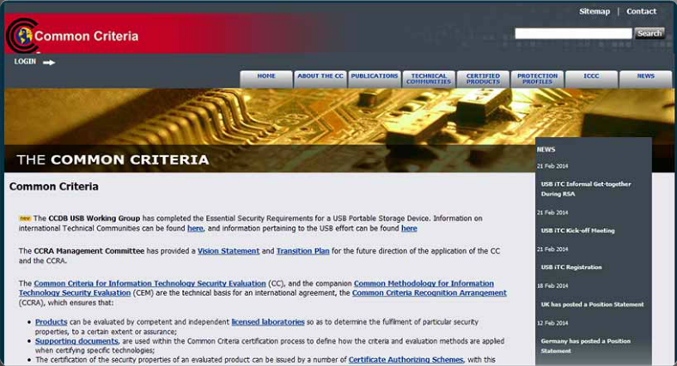
Guideline Documents (Cont.)
Common Criteria Website
Notes:
11.2.3.3 Guideline Documents (Cont.)

Slide 30
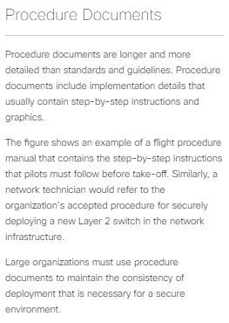

Procedure Documents
Notes:
11.2.3.4 Procedure Documents

Slide 31
Topic 11.2.4: Roles and Responsibilities

Slide 32
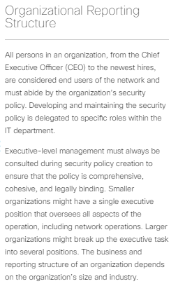

Organizational Reporting Structure
Notes:
11.2.4.1 Organizational Reporting Structure

Slide 33

Common Executive Titles
Chief Executive Officer (CEO)
Chief Technology Officer (CTO)
Chief Information Officer (CIO)
Chief Security Officer (CSO)
Chief Information Security Officer (CISO)
Notes:
11.2.4.2 Common Executive Titles

Slide 34
Topic 11.2.5: Security Awareness and Training

Slide 35

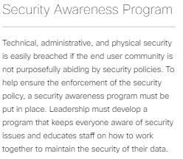
Security Awareness Program
Primary components:
Awareness campaigns
Training and education
Notes:
11.2.5.1 Security Awareness Program
11.2.5.2 Awareness Campaigns
11.2.5.3 Security Training Course
11.2.5.4 Education Program

Slide 36
Topic 11.2.6: Responding to a Security Breach

Slide 37


Motive, Opportunity, and Means
Notes:
11.2.6.1 Motive, Opportunity, and Means

Slide 38
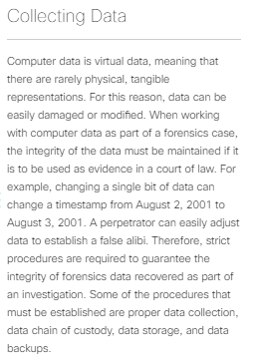

Collecting Data
Notes:
11.2.6.2 Collecting Data

Slide 39
Section 11.3: Summary
Chapter Objectives:
Explain the various techniques and tools used for network security testing.
Explain how to develop a comprehensive security policy.
Notes:
11.3.1.1 Packet Tracer – Skills Integration Challenge
11.3.1.2 Lab – CCNA Security Comprehensive Lab
11.3.1.3 Chapter 11: Managing a Secure Network

Slide 41
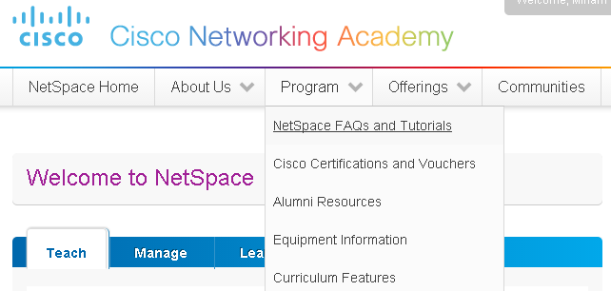
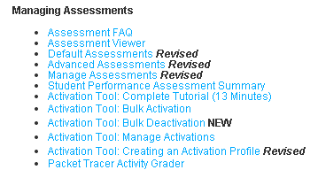
Instructor Resources
Remember, there are helpful tutorials and user guides available via your NetSpace home page. (https://www.netacad.com)
These resources cover a variety of topics including navigation, assessments, and assignments.
A screenshot has been provided here highlighting the tutorials related to activating exams, managing assessments, and creating quizzes.
1
2
Notes:
https://www.netacad.com

